Slide 1
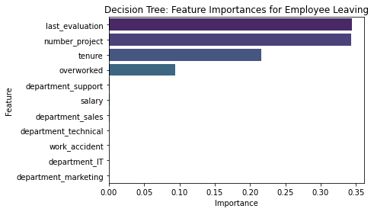
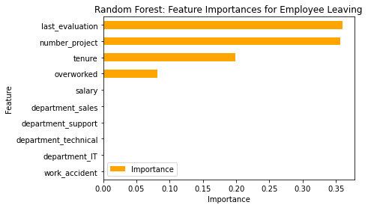
Salifort Motors
Employee Retention Project for the HR Department Sheyenen Cortez
Salifort Motors aims to enhance employee retention by exploring the key factors that contribute to employee turnover. Their central question is: what conditions or patterns are most likely to lead an employee to leave the company?
Because the target variable is categorical, the team can approach the problem using either logistic regression or a tree-based machine learning model. Among these, the random forest model demonstrates a modest performance advantage over the decision tree.
The most important variables are ‘last_evaluation’, ‘number_project’, ‘tenure’ and ‘overworked’.
This model predicts the likelihood of an employee leaving and highlights the key factors driving that outcome. These insights empower HR to make informed decisions aimed at boosting employee retention.
The random forest model shows the same variables as having the greatest significance for an employee deciding to leave the company.
Set a limit on the number of projects assigned to each employee.
Promote employees with at least four years of tenure, or investigate the root causes of dissatisfaction among this group.
Recognize and compensate employees who work extended hours, or reduce the expectation for them to do so.
Ensure employees are aware of the company’s overtime pay policies, and clarify any ambiguous expectations around workload and time off.
Facilitate open conversations at both the company and team levels to better understand and improve workplace culture.
Avoid tying high evaluation scores exclusively to those working 200+ hours per month; instead, adopt a more balanced system that rewards effort and contribution proportionally.

